Slide 1
Queueing Models
Shovan Bhowmik
Lecturer
Dept. of CSE

Slide 2
M/M/1/GD/∞/∞ Queueing System
λ
λ
λ
λ
λ
λ
λ
0
1
2
….
j-1
0
j
j+1
….
μ
μ
μ
μ
μ
μ
Here, λ_{j} = λ j= 0, 1, 2, … ( arrival rate per unit time)
μ₀ = 0
μ_{j} = μ j= 1, 2, … ( service rate per unit time)
Let, the traffic intensity be ρ = λ /μ and 0 ≤ ρ < 1

Slide 3
M/M/1/GD/∞/∞ Queueing System(Cont..)
So,
If ρ ≥ 1, the infinite sum “blows up”, thus, no steady-state distribution exists.
So, rest of this section, we assume ρ < 1.

Slide 4
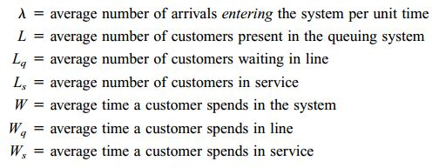
M/M/1/GD/∞/∞ Queueing System(Cont..)
The steady state parameters we are interested in:
L_{S} is also said “Average no. of busy servers”
L = L_{q} + L_{S}

Slide 5
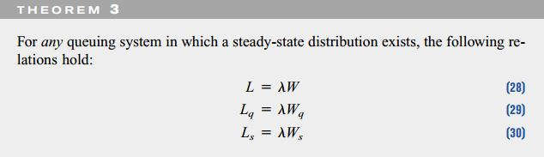
M/M/1/GD/∞/∞ Queueing System(Cont..)
Little’s Queueing Formula: L = λ_{eff} W
Often we are interested in the amount of time that a typical customer spends in a queuing system.
By using a powerful result known as Little’s queuing formula, W and W_{q} may be easily computed from L and L_{q}

Slide 6


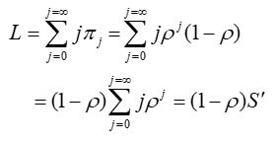




M/M/1/GD/∞/∞ Queueing System(Cont..)
Derivation of L:
We know, E(X) = ∑[x f(x)]
So, L

Slide 7
M/M/1/GD/∞/∞ Queueing System(Cont..)
Derivation of L_{q}:
Let, the system in state j=0,1,2,… with probability π_{j}
i.e. there are j customers in the system now
Since only 1 server, there are j-1 customer is waiting in queue(Assuming 1 server can serve 1 customer only)

Slide 8
M/M/1/GD/∞/∞ Queueing System(Cont..)
Derivation of L_{s}:
As we have already derived L and L_{q} , we can easily find L_{s} from this.

Slide 9
M/M/1/GD/∞/∞ Queueing System(Cont..)
Example(Winston):
An average of 10 cars per hour arrive at a single-server drive-in teller. Assume that the average service time for each customer is 4 minutes, and both inter arrival times and service times are exponential. Answer the following questions:
What is the probability that the teller is idle?
Solution: We have an M/M/1/GD/∞/∞ system with
λ = 10 cars per hour, µ = 60/4=15 cars per hour, ρ = 10/15 = 2/3
Idle probability π₀ = 1 − ρ = 1 – 2/3 = 1/3

Slide 10
M/M/1/GD/∞/∞ Queueing System(Cont..)
Example(Winston):
An average of 10 cars per hour arrive at a single-server drive-in teller. Assume that the average service time for each customer is 4 minutes, and both inter arrival times and service times are exponential. Answer the following questions:
What is the average number of cars waiting in line for the teller? Also find W_{q}
Solution:
L_{q} = ρ²/(1- ρ)= (0.67)²/(1 − 0.67) = 1.36 customers
W_{q} = L_{q}/λ = 1.36/10 = 0.136 hr = 8.16 mins

Slide 11
M/M/1/GD/∞/∞ Queueing System(Cont..)
Example(Winston):
An average of 10 cars per hour arrive at a single-server drive-in teller. Assume that the average service time for each customer is 4 minutes, and both inter arrival times and service times are exponential. Answer the following questions:
What is the average amount of time a drive-in customer spends in the bank parking lot? Also find W
Solution:
L = ρ/(1 − ρ)= .67/(1 − .67) = 2.03 customers
W = L/λ = 2.03/10 = 0.203 hour = 12.18 mins

Slide 12
M/M/1/GD/∞/∞ Queueing System(Cont..)
Example(Winston):
Suppose that all car owners fill up when their tanks are exactly half full. At the present time, an average of 7.5 customers per hour arrive at a single-pump gas station. It takes an average of 4 minutes to service a car. Assume that inter-arrival and service times are both exponential.
What is the probability that the teller is idle?
Solution:
We have an M/M/1/GD/∞/∞ system with
λ = 7.5 cars per hour µ = 60/4=15 cars per hour
ρ = 7.5/15 = 0.5
Idle probability: π₀ = 1 − ρ = 0.5

Slide 13
M/M/1/GD/∞/∞ Queueing System(Cont..)
Example(Winston):
Suppose that all car owners fill up when their tanks are exactly half full. At the present time, an average of 7.5 customers per hour arrive at a single-pump gas station. It takes an average of 4 minutes to service a car. Assume that inter-arrival and service times are both exponential.
For the present situation, compute L , L_{q} and W, W_{q}.
Solution:
L = ρ/(1 − ρ)= .50/(1 − 0.5) = 1
W = L/λ = 1/7.5 = 0.13 hour = 8 mins
L_{q} = ρ²/(1- ρ)= 0.25/(1 − 0.5) = 0.5
W_{q} = L_{q}/λ = 0.5/7.5 =1/15 hr = 4 mins
Hence, in this situation, everything is under control, and long lines appear to be unlikely.

Slide 14
M/M/1/GD/∞/∞ Queueing System(Cont..)
Example(Winston):
Suppose that a gas shortage occurs and panic buying takes place. To model the phenomenon, suppose that all car owners now purchase gas when their tanks are exactly three quarters full. Now each car owner will fill up twice as often. Since each car owner is now putting less gas into the tank during each visit to the station, we assume that the average service time has been reduced to 3 1/3 minutes. How has panic buying affected L and W?
Solution: We now have an M/M/1/GD/∞/∞ system with
λ = 2*7.5 =15 cars per hour
µ = 60*3/10=18 cars per hour.
ρ = 15/18 =5/6

Slide 15
M/M/1/GD/∞/∞ Queueing System(Cont..)
Example(Winston):
Suppose that a gas shortage occurs and panic buying takes place. To model the phenomenon, suppose that all car owners now purchase gas when their tanks are exactly three quarters full. Now each car owner will fill up twice as often. Since each car owner is now putting less gas into the tank during each visit to the station, we assume that the average service time has been reduced to 3 1/3 minutes. How has panic buying affected L and W?
Solution(Cont..) :
Thus, panic buying has caused long lines.

Slide 16
M/M/s/GD/∞/∞ Queueing System
There is a single line of customers waiting to be served at one of s parallel servers.
If j <= s customers are present, then all j customers are in service; if j > s customers are present, then all s servers are occupied, and j – s customers are waiting in line.
λ
λ
λ
λ
λ
λ
λ
0
1
2
….
s-1
0
s
s+1
….
μ
2μ
3μ
(s-1)μ
sμ
sμ
Here, λ_{j} = λ j= 0, 1, 2, …
μ_{j} = jμ j= 0, 1, 2, …,s
μ_{j} = sμ j= s+1, s+2, …
Let, the traffic intensity be ρ = λ /(sμ) and 0 ≤ ρ < 1

Slide 17
M/M/s/GD/∞/∞ Queueing System(Cont..)
Any arrival who finds an idle server enters service immediately, but an arrival who does not find an idle server joins the queue of customers awaiting service.
λ
λ
λ
λ
λ
λ
λ
0
1
2
….
s-1
0
s
s+1
….
μ
2μ
3μ
(s-1)μ
sμ
sμ

Slide 18
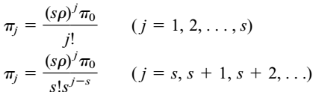
M/M/s/GD/∞/∞ Queueing System(Cont..)
If ρ ≥ 1, the infinite sum “blows up”, thus, no steady-state exists.

Slide 19

M/M/s/GD/∞/∞ Queueing System(Cont..)
Derivation of L_{q}:
We know that, for steady-state probability that all servers are busy
How it comes? ;)

Slide 20


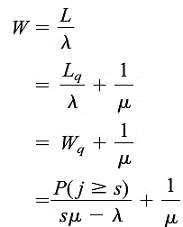



M/M/s/GD/∞/∞ Queueing System(Cont..)
Derivation of L_{q}(Cont..):
Derivation of L_{s}:
Derivation of L:

Slide 21
M/M/s/GD/∞/∞ Queueing System(Cont..)
Example:
A community is served by two cab companies. Each company owns two cabs and both share the market equally as evidenced by the fact that calls arrive at each company’s dispatching office at the rate of eight per hour. The average time per ride is 12 minutes. Calls arrive according to exponential distribution and the ride time is also exponential. The two companies recently were bought by an investor who is interested in consolidating them into a single dispatching office to provide better service to the customers. Analyze the new owner’s proposal.
Solution:
As a M/M/2 system:
λ = 8 μ = 60/12 = 5 s = 2 ρ = λ/sμ= 0.8

Slide 22
M/M/s/GD/∞/∞ Queueing System(Cont..)
Solution(Cont..):
As a M/M/2 system,
λ = 8 μ = 60/12 = 5 s = 2 ρ = λ/sμ= 0.8

Slide 23
M/M/s/GD/∞/∞ Queueing System(Cont..)
Solution(Cont..):
As a M/M/4 system,
λ = 2*8=16 μ = 60/12 = 5 s = 2*2 ρ = λ/sμ= 0.8

Slide 24
M/M/s/GD/∞/∞ Queueing System(Cont..)
Solution(Cont..):
As a M/M/4 system,
λ = 2*8=16 μ = 60/12 = 5 s = 2*2 ρ = λ/sμ= 0.8

Slide 25
M/M/1/GD/n/∞ Queueing System
λ
λ
λ
λ
λ
0
1
2
….
n-1
0
n
μ
μ
μ
μ
μ
Here, λ_{j} = λ j= 0, 1, 2, … n-1
λ_{j} = 0 for j= n
μ₀ = 0
μ_{j} = μ j= 1, 2, … n
Let, the traffic intensity be ρ = λ /μ and ρ ≥ 0

Slide 26
M/M/1/GD/n/∞ Queueing System(Cont..)

Slide 27
M/M/1/GD/n/∞ Queueing System(Cont..)
Derivation of L:
L
How? ;)

Slide 28
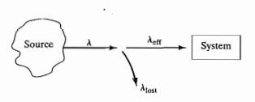
M/M/1/GD/n/∞ Queueing System(Cont..)
Derivation of L_{s}: (No need to write like this)
Derivation of L_{q}:

Slide 29

M/M/1/GD/n/∞ Queueing System(Cont..)
The value of ρ need not be less than 1 in this model, because arrivals at the system are controlled by the system limit n.
λ_{eff} , rather than λ is the rate that matters in this case.
Example(Taha):
A car wash facility with single bay for wash and 4 parking space. Arrival rate = 4 / hr, service time = 10 min / car, all are exponential. Determine the following:

Slide 30
M/M/1/GD/n/∞ Queueing System(Cont..)
Solution:
Here,
a)
b)
(d)

Slide 31
M/M/1/GD/n/∞ Queueing System(Cont..)
Solution(Cont..):
b)(Cont..)
c) Expected no. of empty parking spaces = 4 - L_{q} = 3.212

Slide 32
M/G/1/GD/ ∞ /∞ Queueing System
Inter-arrival times are exponential. Let λ be the arrival rate.
The service time distribution S is not exponential. Let, 1/μ = E(S) and σ² = var S
It is not a birth–death process
because the probability that a service completion occurs between t and t+Δt when the state of the system at time t is j, depends on the length of time since the last service completion.
Determination of the steady-state probabilities for M/G/1/GD/∞/∞ queuing system is a difficult matter.
Fortunately, however, utilizing the results of Pollaczek and Khinchine, we may determine L_{q}, L, L_{s}, W_{q}, W, W_{s}.

Slide 33
M/G/1/GD/ ∞ /∞ Queueing System(Cont..)
Pollaczek and Khinchine formula or Mean Queue Formula states a relationship between the queue length and service time distribution for an M/G/1 queue.
It can also be shown that π₀ = 1 − ρ.
The result is similar to the one for the M/M/1/GD/∞/∞ system.

Slide 34
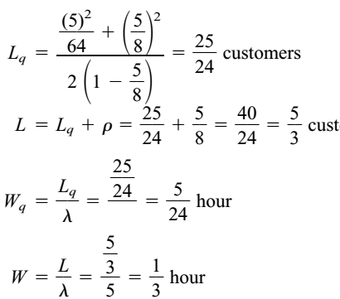
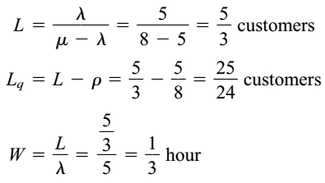

M/G/1/GD/ ∞ /∞ Queueing System(Cont..)
Example: Consider an M/M/1/GD/∞/∞ system with λ = 5 customers per hour and μ = 8 customers per hour.
Considering it as a M/G/1 system,
E(S) =1/μ = 1/8
σ² = 1/μ² =1/64
5
5

Slide 35
M/G/1/GD/ ∞ /∞ Queueing System(Cont..)
G means this can be of any type of general distribution.
For Erlang Distribution:
It is a two parameter family of continuous probability distributions with support x ∈ [ 0 , ∞ ).
The two parameters are:
1. a positive integer k the "shape", and
2. a positive real number λ , the "rate". The "scale", μ , the reciprocal of the rate, is sometimes used instead.

Slide 36
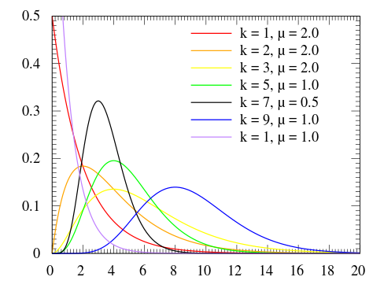


M/G/1/GD/ ∞ /∞ Queueing System(Cont..)
For Erlang Distribution(Cont..):
The probability density function is:
Or,

Slide 37
M/G/1/GD/ ∞ /∞ Queueing System(Cont..)
For Erlang Distribution(Cont..):
Mean: k / λ and Variance: k / λ²
Erlang distribution with k = 1 simplifies to exponential distribution.
Example:
Consider an M/G/1/GD/∞/∞ queuing system in which an average of 10 arrivals occur each hour. Suppose that each customer’s service time follows an Erlang distribution, with rate parameter 1 customer per minute and shape parameter 4. (Winston page: 1098)

Slide 38
M/G/1/GD/ ∞ /∞ Queueing System(Cont..)
Example(Cont..):
Find the expected number of customers waiting in line.
Find the expected time that a customer will spend in the system.
What fraction of the time will the server be idle?
Solution:
Since it’s an Erlang Distribution,

Slide 39
M/G/1/GD/ ∞ /∞ Queueing System(Cont..)
Solution(Cont..):
a)
b)
c)

Slide 40
Problems
Winston Book:
M/M/1 model: Example 3, 4, Exercise: 4, 7
M/M/s model: Example: 9, 10, Exercise: 1, 9, 10
Taha Book:
Example: 15.6-2, 15.6-4, Problem set: 15.6D(Related math)
Slide Problems

Slide 41
References
Operations Research Applications and Algorithms(4th Edition) – Wayne L. Winston
Operations Research, An Introduction(8th Edition) – Hamdy A. Taha
Internet Resources

Slide 42


